Slide 1
secure data hiding in images using steganography
CAPSTONE PROJECT
Presented By:
Student Name : SREYASH SOMESH MISHRA
College Name & Department : BIRLA INSTITUTE OF TECHNOLOGY AND SCIENCE PILANI, HYDERABAD CAMPUS
B.E. Electronics & Instrumentation

Slide 2
OUTLINE
Problem Statement
Technology used
Wow factor
End users
Result
Conclusion
Git-hub Link
Future scope

Slide 3
Problem Statement
With increasing digital communication, securing sensitive information is crucial. Traditional encryption methods protect data but may attract attention. Image steganography offers a covert way to embed secret messages inside images, making them indistinguishable from regular media. This project uses Least Significant Bit (LSB) steganography combined with Fernet encryption to securely hide and retrieve messages within images, ensuring confidentiality and preventing unauthorized access.

Slide 4
Technology used
Programming language: Python
Libraries:
OpenCV – for image processing
String – for text manipulation
Cryptography – for encrypting hidden message
Platforms:
VS code
GitHub

Slide 5
Wow factors
1. Dual-layer security (encryption + steganography) – this project encrypts the message using Fernet encryption before embedding it.
2. Least significant bit encoding for minimal distortion
3. Automatic key generation and secure storage
4. Supports multiple image formats
5. Error handling
6. Scalable and extendable

Slide 6
End users
This project can be useful for various individuals and organizations that require confidential data transmission and information security.
Cybersecurity professionals and ethical hackers
Intelligence agencies and anti-fraud teams
Private individuals and businesses

Slide 7
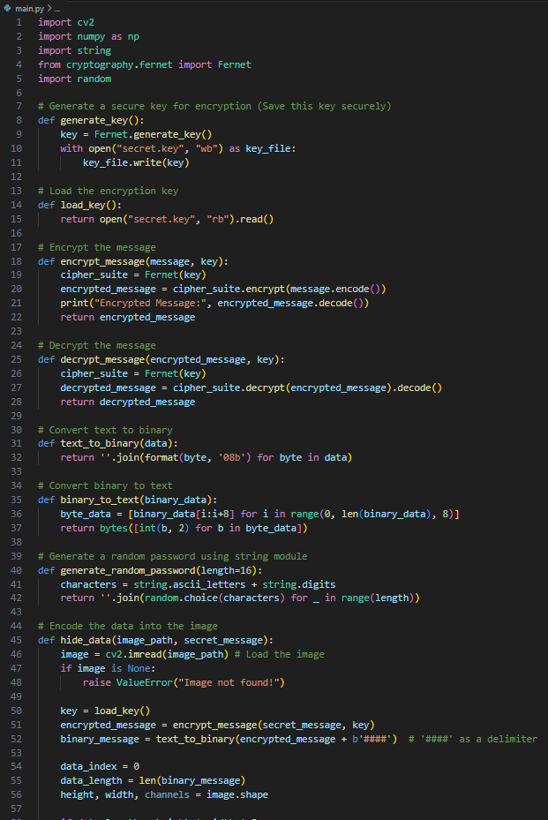
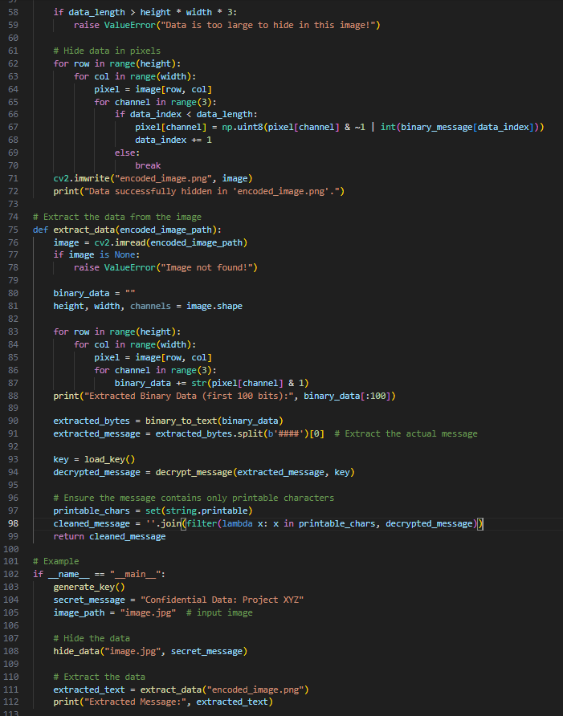
Results

Slide 8
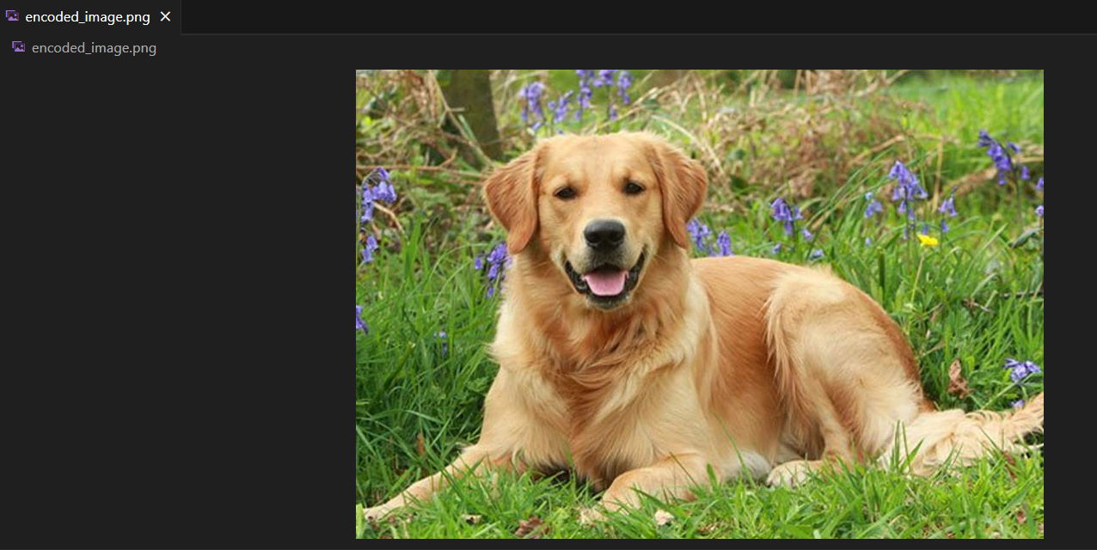
Results
Encoded image

Slide 9
Conclusion
This project successfully implements secure data hiding using image steganography by combining Least Significant Bit (LSB) encoding with Fernet encryption. The system first encrypts the secret message to ensure confidentiality, then embeds it into an image without noticeable visual changes. By leveraging OpenCV, NumPy, and Cryptography, this project provides a robust method for covert communication and data protection.
The project demonstrates the effectiveness of steganography as a secure and discreet data-hiding technique, suitable for cybersecurity, secure messaging, and digital watermarking applications. Future improvements can include support for hiding larger files, GUI integration, and advanced encryption techniques for enhanced security.

Slide 10
GitHub Link
https://github.com/Sreyash03/Steganography

Slide 11
Future scope
This project can be enhanced by integrating a GUI for better user experience and expanding support to hide larger files like PDFs and videos.
Additionally, implementing advanced encryption techniques and AI-based steganalysis resistance can further improve security, making it more robust against detection and attacks

Slide 12
THANK YOU

